Slide 1

Expert Evidence
Nick Taylor

Slide 2
What will today cover?
What expert evidence is
When it will be needed
When to think about it – the lifecycle of a case
Part 35 recap (plus other relevant Civil Procedure Rules)
Instructions and privilege
What makes the ‘best’ expert?
Griffiths v TUI – expert evidence in the Supreme Court
Useful references

Slide 3
What is expert evidence?
Evidence given by an expert
Why do we have it and what is its purpose?
“It is trite law that the role of an expert is to assist the court in relation to matters of scientific, technical or other specialised knowledge which are outside the judge’s expertise by giving evidence of fact or opinion; but the expert must not usurp the functions of the judge as the ultimate decision-maker on matters that are central to the outcome of the case.”
Per Lord Hodge in Griffiths v TUI UK Ltd [2023] UKSC 48 at [36]
Not today considering the role of an expert advisor

Slide 4
When will it be needed (and permitted)?
Is there an issue in the case requiring evidence of opinion, evidence of a technical or scientific nature?
Is expert evidence necessary to decide the issue? If yes, expert evidence will be needed and will be allowed
If not necessary, will it nevertheless assist the Judge in determining an issue? If yes, then consider factors such as proportionality, cost, impact on trial timetable etc.

Slide 5
When will it be needed?
Some Examples
Professional negligence (but not every allegation of negligence and not generally for lawyer’s negligence)
Foreign law (see e.g. paras. 9.46 – 9.50 of the Chancery Guide)
Boundary disputes
Quantum issues, e.g. loss of profit claims, company valuations (especially in s994 CA 2006 petitions)

Slide 6
When should you think about it?
ASAP!
In some cases will be obvious pre-action
Before or after pleadings?
Per Coulson J in Pantelli Associates Ltd v Corporate City Developments Number Two Ltd [2010] EWHC 3189 (TCC): how could it: “…be asserted that act x was something that an ordinary professional would and should not have done, if no professional in the same field had expressed such a view.”

Slide 7
CPR Part 35 recap
Part 35:
CPR 35.1 – “Expert evidence shall be restricted to that which is reasonably required to resolve the proceedings.”
CPR 35.2 – overriding duty to the Court
CPR 35.4(1) – “No party may call an expert or put in evidence an expert’s report without the court’s permission”
Burden on the party seeking permission

Slide 8
CPR 35 – applications for permission
CPR 35:
CPR 35.4(2) – “When parties apply for permission they must provide an estimate of the costs of the proposed expert evidence and identify—
the field in which expert evidence is required and the issues which the expert evidence will address; and
where practicable, the name of the proposed expert.”
Directions questionnaires, costs budgets and case management information sheet (Commercial Court)

Slide 9
Practice Direction 35
Always check that any report satisfies the requirements of PD35, in particular:
Para. 2.4 – question or issue outside their expertise or unable to reach definite opinion
Para 3.2 (form and content):
“(6) where there is a range of opinion on the matters dealt with in the report—
summarise the range of opinions; and
give reasons for the expert’s own opinion;”

Slide 10
Small claims, intermediate track and fast track
Small claims – CPR 27.2(e) generally disapplies CPR 35
Permission still required (CPR 27.5) but a more flexible approach to evidence (e.g. the form and contents of report)
Note fixed recoverable sum of £750 for expert (CPR 24.14(2)(g))
Intermediate track – generally one oral expert per party and 20-page limit for reports (CPR 28.14(2)(a))
Fast track – typically written report of SJE

Slide 11
Privilege and expert evidence
Litigation privilege – documents prepared “for the dominant purpose of
litigation which is ongoing or reasonably in contemplation”
CPR 35 = experts who are instructed for purpose of proceedings
Instructions to expert not privileged but not ordinary disclosable (CPR 35.10(4) but note CPR 35.10(3))
So be wary of providing experts with privileged material and draft instructions to
experts with care
Draft reports – generally thought to be privileged (Jackson v Marley Davenport Ltd [2004] EWCA Civ 1225):
"There can be no doubt that, if an expert makes a report for the purpose of a
party's legal advisers being able to give legal advice to their client, or for
discussion in a conference of a party's legal advisers, such a report is the subject matter of litigation privilege at the time it is made. It has come into existence for
the purposes of litigation. It is common for drafts of expert reports to be
circulated among a party's advisers before a final report is prepared for exchange with the other side. Such initial reports are privileged.” (Longmore LJ at para. 13)

Slide 12
Privilege and expert evidence
Substituting experts and “expert shopping”:
"Parties should be aware that the court discourages the practice of ‘expert shopping’, in the sense of casting around for a more favourable expert opinion in place of one already obtained. The court can, and ordinarily will, require a party to waive privilege in a previous expert’s report* as a condition of granting permission to adduce evidence from a different expert (see, for example, Edwards-Tubb v J D Wetherspoon [2011] EWCA Civ 136).” (paragraph 9.20 of the Chancery Guide)
*(draft or final reports of an earlier expert)
Avantage (Cheshire) Limited and others v GB Building Solutions Limited and others [2023] EWHC 802 (TCC) at para 17

Slide 13
What makes the ‘best’ expert? Big points
Expertise - De Sena v Notaro [2020] EWHC 1031 (Ch) – expert
evidence disregarded as experts did not have sufficient
expertise in respect of demerger transactions:
“Those firms that provide expert witness services really ought to have learned by now that expertise is acquired by doing the thing in
question, usually over many years, and that merely being an
accountant (or anything else) for a long time does not mean that you
thereby become an expert in everything that accountants (or
whatever it may be) commonly do.” (para. 157 per HHJ Paul Matthews)
No conflicts of interest - Essex County Council v UBB Waste
(Essex) Ltd [2020] EWHC 1581 (TCC). Expert had clear (personal) interest in defeating claimant’s claims – Judge
attached little weight to evidence (and may have excluded
report had issue arisen sooner)

Slide 14
What makes the ‘best’ expert? Finer points
Real world experience vs experience as a professional witness
“It seems to me that the court would ordinarily in a case such as this find more helpful the evidence of someone who has actually (if I can
put it in the vernacular) got their hands dirty in the marketplace by
advising clients in the real world of acquisition and merger activity.”
(Re Sunrise Radio [2011] EWHC 3821 (Ch))
Excessive partisanship
“…extremely (heroically) favourable [to his client]…” (R (on the
application of British American Tobacco UK Ltd) v Secretary of State for Health [2016] EWHC 1169 at [700])
“unrealistic” assumptions “…which perhaps indicates he had
identified too much with [his client’s] case.” (Interdigital Technology Corp v Lenovo Group Ltd [2023] EWHC 539 (Pat) at [85])

Slide 15

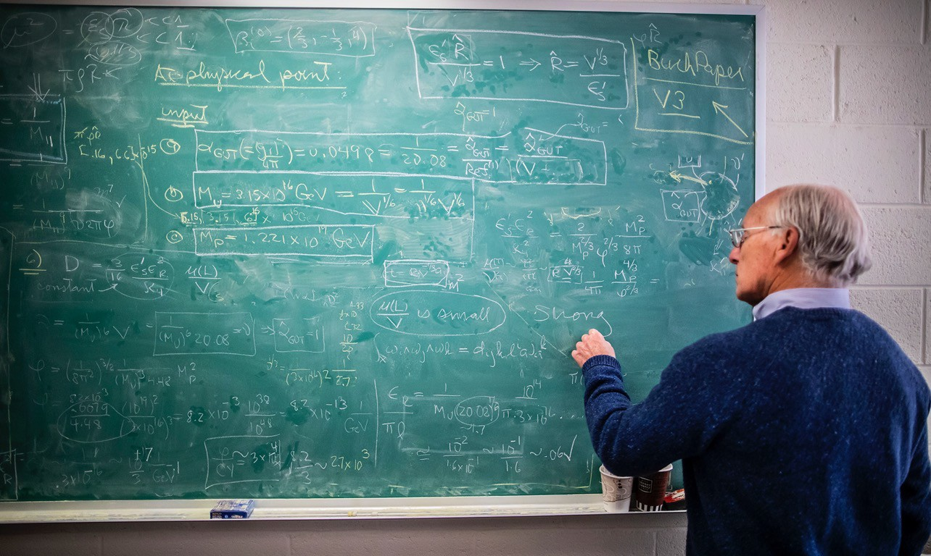
What makes the ‘best’ expert?
My view - a teacher, not a lecturer

Slide 16
Griffiths v TUI UK Ltd [2023] UKSC 48
Expert evidence in the Supreme Court
Uncontroverted expert evidence not challenged until closing
submissions
Requirements of a fair trial (no trial by ambush):
“In general a party is required to challenge in cross - examination the
evidence of any witness of the opposing party if he wishes to submit to the court that the evidence should not be accepted on that point.
The rule applies in civil cases … In general the CPR does not alter that
position. This rule serves the important function of giving the witness
the opportunity of explaining any contradiction or alleged problem
with his evidence. If a party has decided not to cross-examine on a particular important point, he will be in difficulty in submitting that
the evidence should be rejected.” (Phipson on Evidence, 20th Edn,
endorsed by Lord Hodge in Griffiths at paras 42 and 43)

Slide 17
Griffiths v TUI UK Ltd [2023] UKSC 48
Exceptions (non-exhaustive) (Griffiths at [61 – 69], for example:
Matter challenged collateral or insignificant (if so, query why
challenge it?)
Evidence is incredible
Evidence is bare conclusion unsupported by reasoning
Clear mistake on the face of the report
Expert afforded opportunity to clarify their report or respond
to criticism
Failure to comply with CPR PD35
Despite Griffiths, Court is not a rubber-stamp for
uncontroverted expert evidence – but challenge it in XX!

Slide 18
Finally - where to go if you get stuck
CPR Part 35 and the Notes to the White Book
Practical Law: “Expert evidence: an overview”, “Experts and privilege”
Phipson on Evidence, Chapter 33 (in particular Sections 5 and 10)
Court Guides:
TCC Guide: Section 13
Chancery Guide: Chapter 9
Commercial Court Guide: Section H2
ntaylor@kingschambers.com

